Slide 1

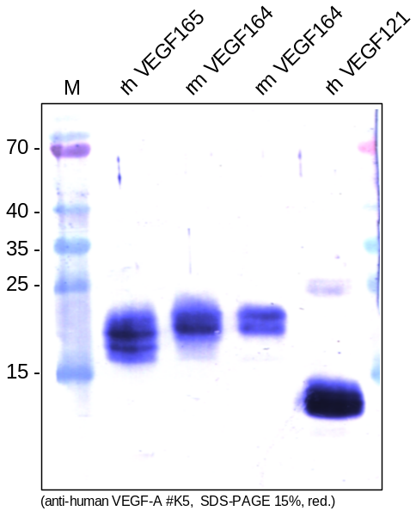
ReliaTech GmbH
Rabbit anti-human VEGF-A #K5
(Cat #102-PA02)
Figure 1. Western analysis of recombinant human VEGF165 [Cat# 300-036], mouse VEGFG164 [Cat# M30-002] and human VEGF121 [Cat# 300-032] using a rabbit polyclonal anti-human VEGF-A antibody [Cat# 102-PA02]. SDS-PAGE was run under reducing conditions.
http://www.reliatech.de / orders@reliatech.de

